Slide 1
DRL

Slide 2
Background
Deep learning is a branch of machine learning, based on brain-inspired architectures and artificial neurons as units of compute, characterized by deterministic activation functions in each artificial neuron, back propagation for training, and many layers of neurons (hence “deep learning”).
Fully-connected (FC) networks connect each neuron in each layer to each neuron in the adjacent layers, requiring a massive number of training parameters.
Convolutional neural networks (CNNs) drastically reduce the number of connections using locality properties of data.
Recurrent neural networks (RNNs) add “memory” or state; output of a network depends on the input as well as the current state.
All of the above are supervised learning and require millions of examples.
DRL is part supervised part unsupervised, allowing the system to learn from experience.

Slide 3
DRL: Introduction
The environment (home)
The state (TV responses)
The agent (Baby).
Agent actions to the environment (press button, tending to go to the one’s he likes the most),
Environment replies with observations and rewards (score, rewards, )

Slide 4
Env methods
Reset: reset the environment state
Step: Step the environment by one timestep returning observation, reward, done or info.
Render: frames in the environment.

Slide 5
What Makes a DRL Problem
Classic DL: We need a loss function!
Loss: “How wrong am I” given a sample?
Key problem: Loss must be differentiable! This limits the cases where you can use it!
Deep reinforcement learning (DRL) needs three things:
State: a representation of our environment (e.g., a picture of a chess board)
Actions: a set of things we can do in that environment
Rewards: positive feedback given from state transitions; does not need to be differentiable
With DRL, as long as we can simulate a process, we can learn it—just need to know (Current State, Action) -> (Next State, Reward)

Slide 6
DRL in the Wild
DeepMind: playing Atari games (2013)
Guided policy search for robotics (2015)
MIT autonomous vehicle using DRL (2016)
DeepMind: AlphaGo (2016)
Defeated human go world champions
DeepMind: AlphaZero (2017)
Defeated computer world champions in chess, go, shogi
Learned from scratch in under 4 hours

Slide 7
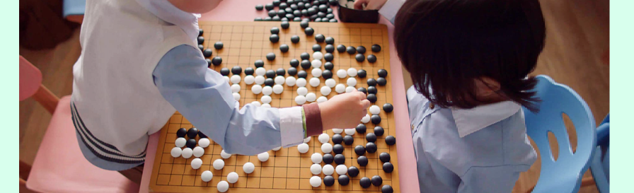
What is GO ?
Two players, using either white or black stones, take turns placing their stones on a board. The goal is to surround and capture their opponent's stones or strategically create spaces of territory.
There are an astonishing 10 to the power of 170 possible board configurations - more than the number of atoms in the known universe.

Slide 8

Deepmind AlphaZero AlphaGO
Self taught system that learnt from scratch Chess, Shogi, and Go
Chess masters analyzed it’s playing style and labeled as "unconventional” and “new”.
Replaced the hand-crafted rules with a deep neural network and general purpose algorithms with the just the basic rules of the games.
Played millions of games against itself learning from all the results, adjusting parameters (9 hours to train for chess, 12 hours for Shogi, 13 days for Go)

Slide 9
Is DRL Applicable in My Area?
The first step is to allow DL agents to start making decisions for themselves and have them better themselves through experience
Examples
Resource management in Datacentre's with Deep Reinforcement learning, minimize job slowdowns
Traffic light control, multi line intersection control flows, reduction in delay was used as metric for rewards.
Robotics, application of CNN’s on image input for management of motor torques.
Web system 3 tier architecture configuration, action space defined as increase, decrease or keep, target action was response time.
Chemistry, reduce time and errors on stable environments of know reactions.

Slide 10

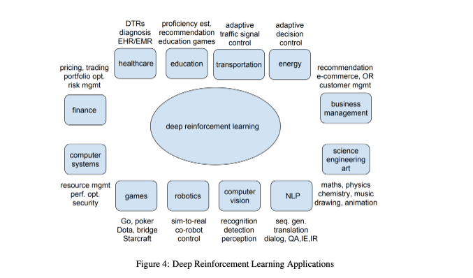
Not just games.

Slide 11
Decision making
Understand the problem, trial an error and benefit from feedback.
Could it be simulated in a safe environment (self driving cars)
Does it fit into the Markov decision process (MDP)

Slide 12
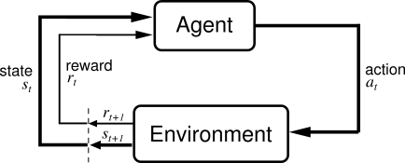
DRL Fundamentals: RL Basics
Reinforcement learning is much older than deep learning. The idea of an agent acting in an environment receiving rewards is old.
How does DL fit in?
At minimum: Given s, how do we better choose a?
Objective for this model: Maximize cumulative discounted rewards (i.e., r).
Discounted rewards: $100 today is worth more than $100 in a year, so we tend to make agents somewhat “greedy” to help them learn.

Slide 13
Making RL Deep: Q Learning
Most famous from Google’s Atari paper!
Q learning is based on a “Q function” and a discrete space of possible unique actions (usually a very short list of actions—like “move left” or “move right”).
Q function: Given an action and a state, what is our expected discounted cumulative R at the end of the simulation, given we choose the optimal action at every step?
Problem: We don’t know optimal action at every step unless we know Q!
Chicken and egg problem!
Use DL to approximate Q for each action, state pair—then always pick the action that scores the highest!

Slide 14
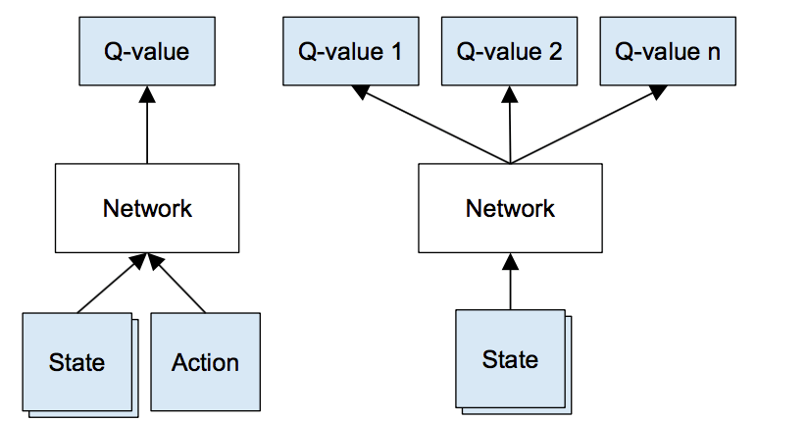
Q Learning
Two possible ways of setting up this problem
(We usually pick the second—the state here might be, for example, an image of the game and so on, the network would be a CNN, and each output is just a single positive real number)
Problem: How do we get a Q-value for each possible action 1,2...n?

Slide 15
Q Learning
What if we assume our network is already perfect (i.e., given any state and action it knows what the total rewards will be)?
Problem becomes much easier
Action A in State 0 will give us (State 1, A)
Feed (State 1, A) into network—it will give us Q for every action at next state; remember the max reward possible for Action A!
Now go back to State 0 and try Action B, which will give us a different state and thus a different max reward for Action B

Slide 16
Q Learning
So we use the network in its present state to generate its own outputs
It looks at every outcome and makes a judgment call on whether the outcome is good or bad
Remember that all the network needs as input is a state—and we know via simulation what state will result from each action, so just show every outcome state to the network!
Easier when illustrated...

Slide 17
Q Learning Illustrated
State ‘Left 1’
State ‘Right 1’
‘Left’
‘Right’
Network
Initial state

Slide 18
Q Learning Illustrated
Evaluate
State ‘Left 1’
State ‘Right 1’
Max is 27!
‘Left’
‘Right’
Left:
Q* = 27
Right:
Q* = 4
Network
Network
Evaluate
Initial state
State ‘Left 1’

Slide 19
Q Learning Illustrated
Evaluate
State ‘Left 1’
State ‘Right 1’
Max is 27!
Update
‘Left’
‘Right’
Left:
Q* = 27
Right:
Q* = 4
27
‘Right’
Network
Network
Network
Evaluate
Go back
Initial state
State ‘Left 1’
Initial state

Slide 20
Q Learning Repeated
Evaluate
State ‘Right 1’
Max is 14!
Update
27
‘Right’
Left:
Q* = 14
Right:
Q* = 2
27
14
Network
Network
Network
Evaluate
Go back
Initial state
State ‘Right 1’
Initial state

Slide 21
Q Learning First Training Sample
Left:
27
Right:
14
Network
Initial state
We now how our inputs (state), outputs (action, reward pairs), so...
We have our first training sample for our network!
Results will essentially be totally random at first, but network will improve with time!

Slide 22
Q Learning First Training Sample
Left:
27
Right:
14
Network
Go left!
State 2
Initial state
At runtime it is easy to decide on an action!
But note that for training we could feed any state into the network—it doesn’t have to be a sequential process, and it doesn’t really matter what action we choose to generate our next sample. This is what makes Q learning an “off-policy” method!
This is nice for parallelizing and for exploration/“what-if” scenarios!

Slide 23
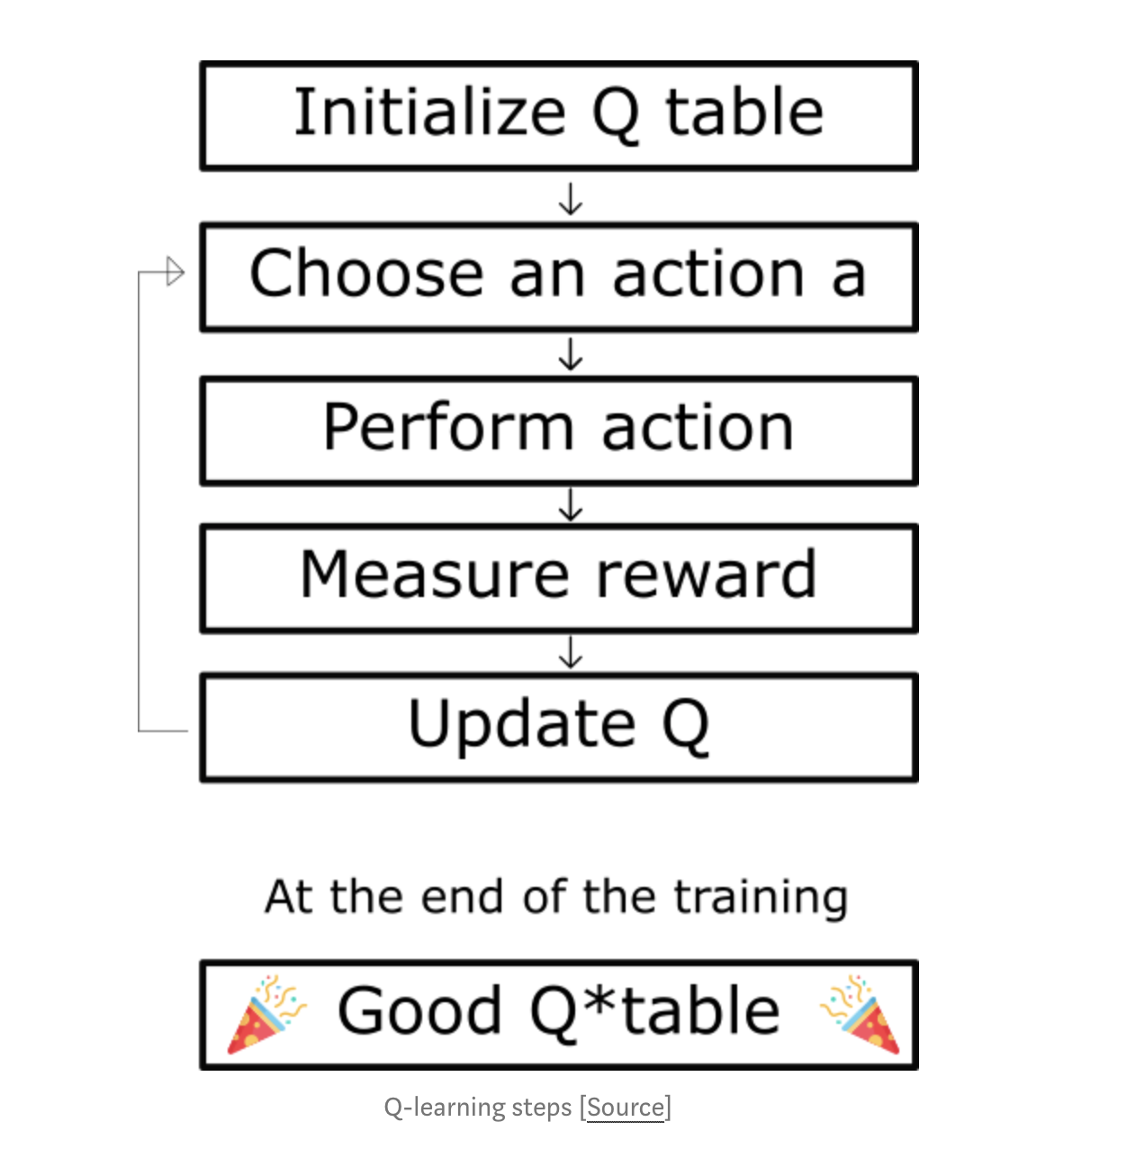
Full process

Slide 24
Terminology and Formalism
Reward at time t:
State at time t:
Action at time t
Discount factor:
Transition probability:
Policy:
r_{t}
s_{t}
a_{t}
𝛾
P(s, a)
𝛑
Follow policy 𝛑; at time t, observe state s_{t} and select action a_{t} based on the policy
Receive reward r_{t} = R(s_{t},a_{t})
Continue to next state = s_{t+1} = S(s_{t},a_{t})
Cumulative discounted reward: ∑_{t≥0} 𝛾^{t}r_{t}
Objective: find policy 𝛑* that maximizes this cumulative discounted reward (randomness, time to completion, etc.)
Value of a state s: V^{𝛑}(s) = ∑_{t≥0} 𝛾^{t}r_{t} |s₀ = s,𝛑
Q-value function in state s and action a: Q^{𝛑}(s,a) = ∑_{t≥0} 𝛾^{t}r_{t} |s₀ = s,a₀ = a, 𝛑

Slide 25
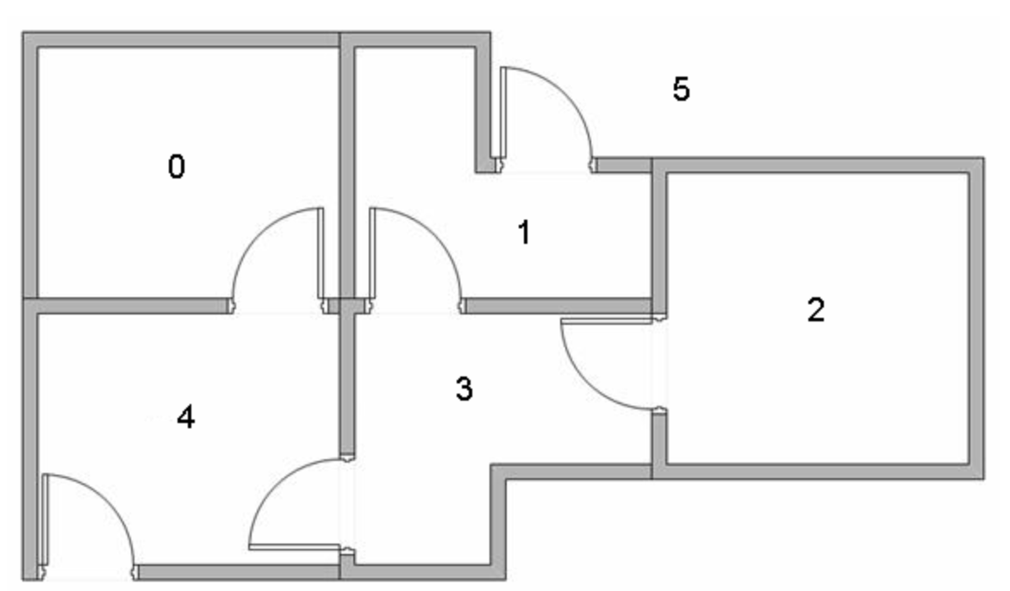
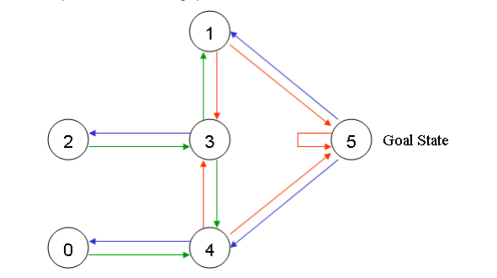
Q-learning example

Slide 26
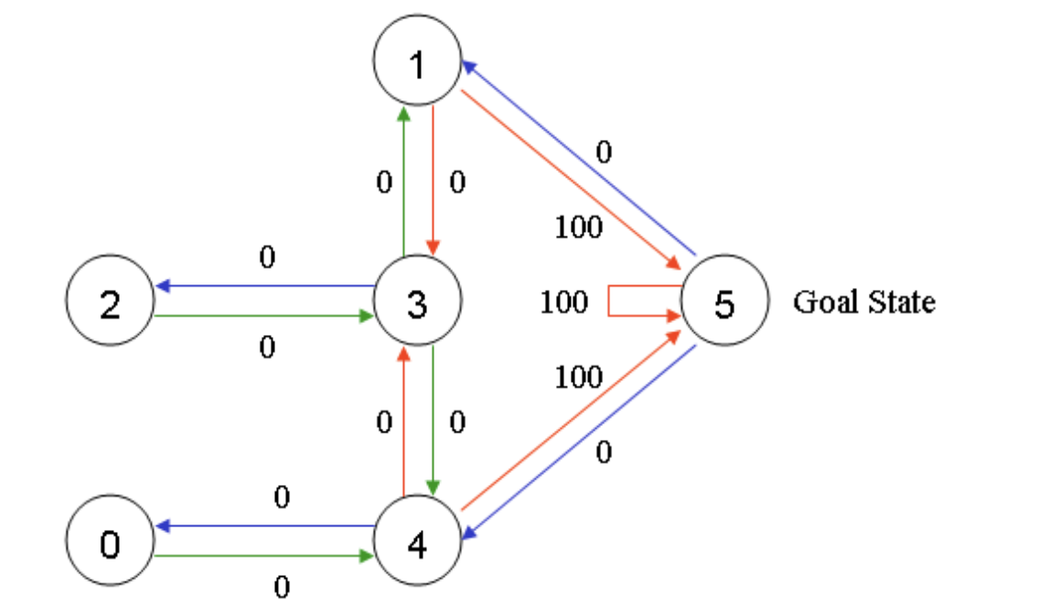
Q-learning example

Slide 27
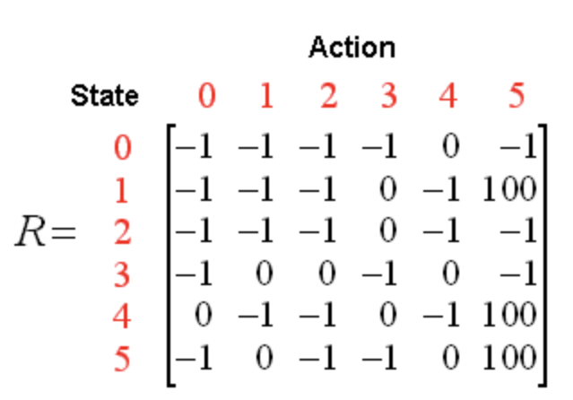
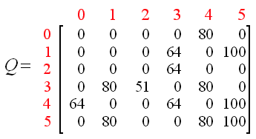
Q-learning example
Q(state, action) = R(state, action) + Gamma * Max[Q(next state, all actions)]

Slide 28
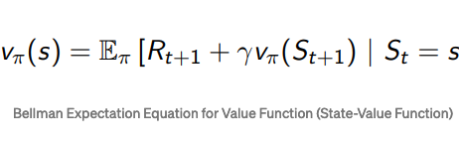
Bellman equation

Slide 29
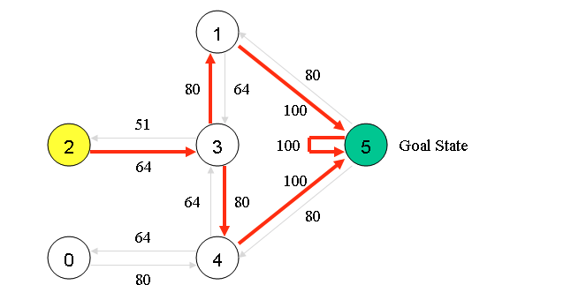
Q-learning example

Slide 30
DRL Application: OpenAI Gym
https://github.com/openai/gym
Key concepts: agent, environment
You take “actions” that take you between “states” with “rewards”
State, reward, done, info = env.step(action)
You play “episodes” one action at a time until “game over” or “done”
Play many episodes until properly trained
Typically, requires X, but could be embedded into Jupyter
Comes with a number of environments
Atari games, box2d, Classic Control, and so on
Full list: https://gym.openai.com/envs/

Slide 31
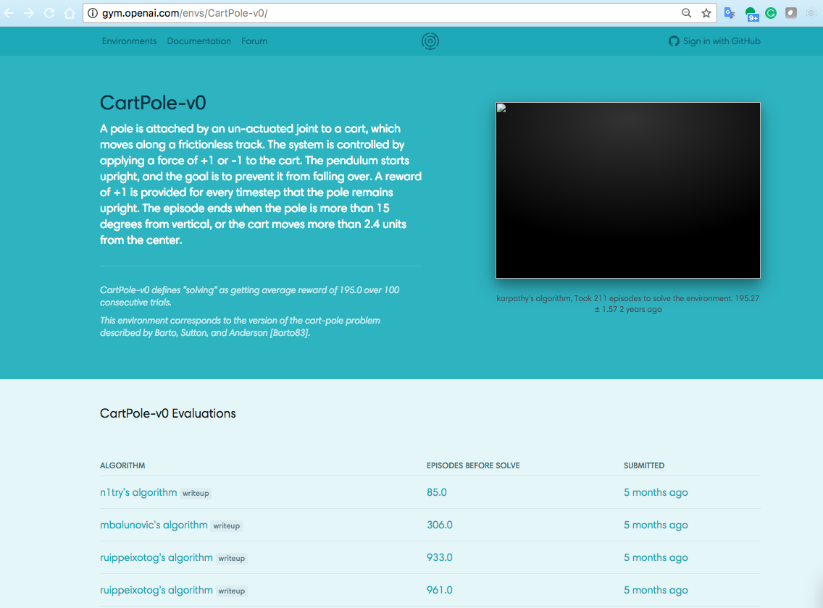

Slide 32
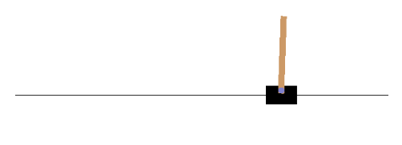
DRL Application: CartPole
State: x_cart, v_cart, x_tip_pole, v_tip_pole
Implementation: Keras, Jupyter (frames saved to animated gif)
Algorithm: DQN with experience replay
Simple feed forward network, two layers
OK on CPU

Slide 33
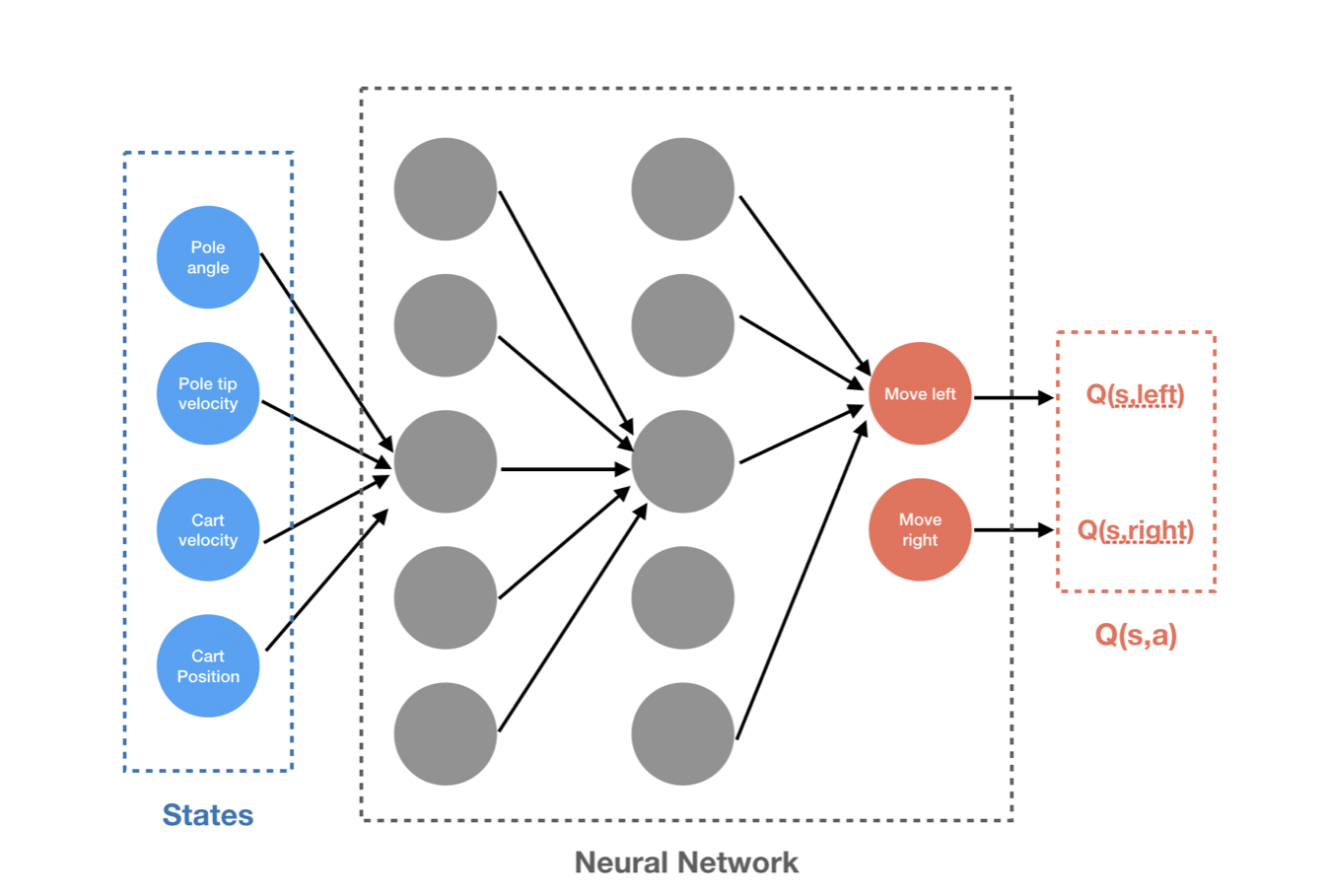
Deep Q-learning

Slide 34
Conclusion
Deep reinforcement learning is a very powerful semi-supervised technique.
They are able to self-learn by interacting with the environment (e.g., in robotics, autonomous driving).
On a number of applications (chess, go), DRL is able to exceed human performance.
As we move toward autonomous agents in health care, DRL should become increasingly more relevant .
It should be particularly useful when analyzing long-term behavioral patterns (e.g., courses of treatment for chronic diseases, disease avoidance).

Slide 35
Resources
Stanford CS 231n: Lecture on DRL (2017)
UC Berkeley CS 294 (2017)
University College London David Silver DRL Class (2015)
Andrei Karpathy’s blog post on DRL
OpenAI Gym
Berkeley Ray
PyTorch DQN tutorial
WildML DRL Resources and code

